Slide 1
PAKISTAN CPEC MEGA-PROJECTS
13/12/2025
COURSE: Project Management Principles and Practices
GROUP MEMBERS
WARDA ZUBAIR
MAHEEN AHMED
ALISHBA ALI
ARWA AMIR

Slide 2
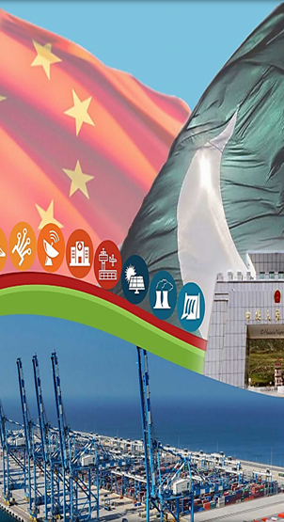
Introduction
CPEC stands for China–Pakistan Economic Corridor.
Flagship development project
BRI- new silk roads
Formally started in 20 April,2015
Total budget $ 62-65 billion
Enhance connectivity, trade & communication

Slide 3
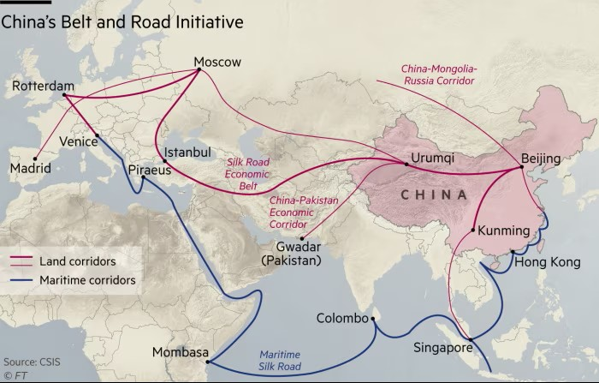
BRI

Slide 4
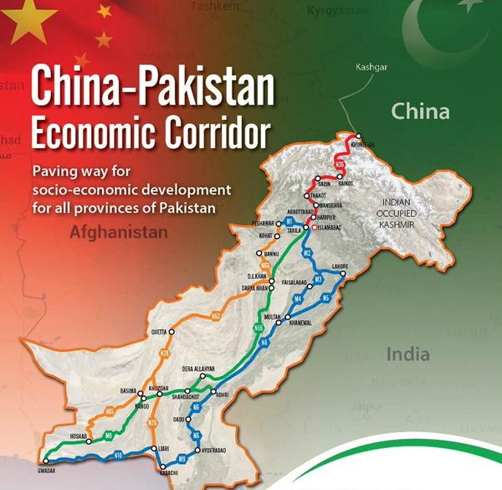
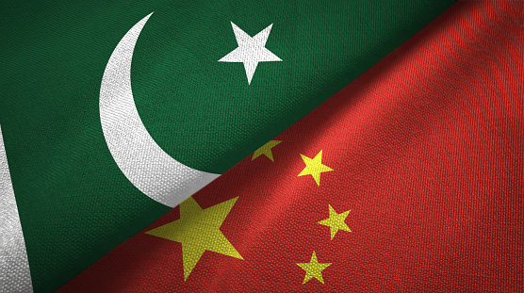
MAP OF CPEC

Slide 5
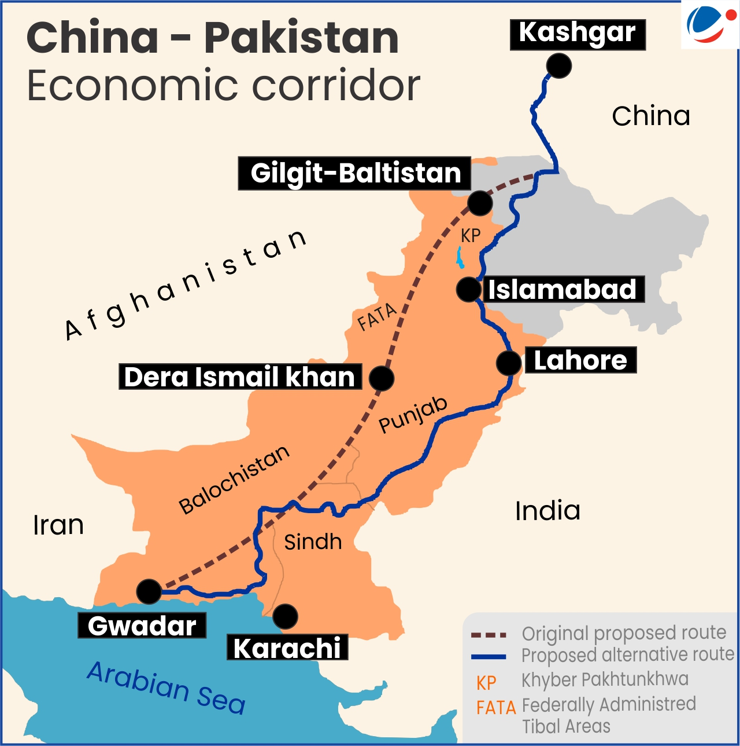

Slide 6
Project Background & Significance
The Pakistan–China economic Corridor (CPEC) was jointly proposed by Pakistan and China formally launched in April 2015 under China’s Belt and Road Initiative.
Pakistan supported CPEC to address energy shortages, weak infrastructure, unemployment, and slow economic growth, while China aimed to improve regional connectivity and trade routes.
A long-term development plan was created focusing on energy projects, transport infrastructure, Gwadar Port, and Special Economic Zones.
CPEC strengthens Pakistan–China strategic partnership, improves Pakistan’s economic and energy capacity, and provides China a shorter, safer access to global trade routes

Slide 7
STAKEHOLDER MAP
Planning Commission of Pakistan
Security Agencies
International Financial Institutions
Government of Pakistan (Federal)
Government of China
CPEC Authority
Chinese Financial Institutions
Power
Local Communities
Media
Provincial Governments
Gwadar Port Authority
  Pakistani Private Sector & Contractors
Interest

Slide 8
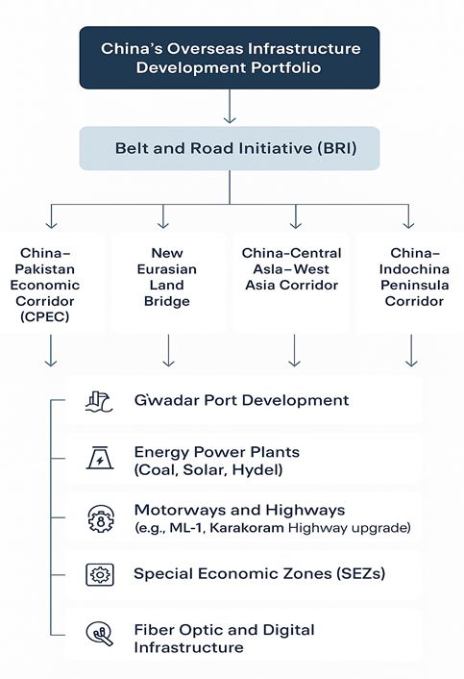
Key Challenges complexity
Program complexity: CPEC is a multi-sector program composed of multiple interdependent projects across provinces with varied governance rules.
Cross-jurisdiction coordination: federal–provincial tensions, differing provincial priorities (e.g., perception of unequal benefits).
Technical complexity: integration of transport, energy and SEZs with differing technical standards and procurement models.

Slide 9
Key challenges
Risk, Cost, Scope
SECURITY RISKS
Terrorist attacks on workers
Attacks in Balochistan
Safety concerns for Chinese engineers
POLITICAL RISKS
Government changes
Policy changes
Different political priorities
ECONOMIC RISKS
Weak Pakistani currency
Inflation
Debt pressure
COST AND SCOPE:
CPEC was initially announced in 2013 with an estimated cost of US $46 billion, which was later revised to around US $62–65 billion as more projects were added.
Major cost challenges are increased scope, increase in external debt, as a large portion of CPEC financing consists of loans that require long-term repayment.

Slide 10
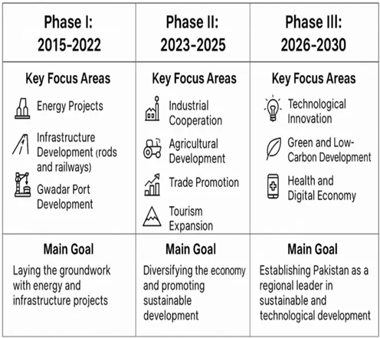
Key Challenges
Schedule
Phase I delays (2015–2022) occurred due to security concerns, land acquisition issues, and energy project complexities, slowing early infrastructure completion.
Phase II (2023–2025) faced setbacks due to economic constraints, financing issues, and global shocks (e.g., COVID-19, inflation), delaying industrial and agricultural projects.
Phase III scheduling risks (2026–2030) include technological readiness, skilled workforce gaps, and sustainability challenges, which may impact long-term goals.

Slide 11
METHODOLOGIES
01
02
03
Program & Portfolio Management: CPEC is managed as a portfolio of sector-based projects under centralized oversight by the Planning Commission and CPEC Authority.
Traditional (Waterfall) Execution: Most road and energy projects follow a linear, plan-driven approach suited to large infrastructure development.
PPP & EPC Models: Several energy and infrastructure projects are delivered through public–private partnerships, EPC contracts, and state-led financing.
Limited Agile Use: Due to the nature of infrastructure work, Agile use is limited; however, hybrid and adaptive governance approaches are gradually being explored
04

Slide 12
SUCCESSES
Energy capacity added: multiple thermal & hydro plants commissioned, helping to reduce short-term supply gaps.
Transport corridors: completion of major motorway sections, upgrades to KKH phases, improved connectivity in several provinces.
Gwadar: port infrastructure has been developed and operationalized at basic levels (ongoing development).
Job creation & localized economic activity: construction jobs and some skills transfer reported; benefits concentrated in project areas.

Slide 13
Failures
SEZs lagging: Several planned Special Economic Zones remain delayed or underperforming, with slow development and limited operational activity.
Debt & financing concerns: International assessments highlight fiscal pressure and heavy reliance on Chinese loans, leading to debt renegotiations in some projects.
Limited domestic value addition: Many projects show weak integration with local industries, with high dependence on imported inputs and contractors.
Transparency & governance gaps: Concerns exist regarding limited public disclosure, contract transparency, and unequal distribution of benefits among provinces

Slide 14
Success or Failure ?
CPEC is a mixed bag, a partial success in some areas like energy (reducing power shortages) and infrastructure, but a failure to deliver its grand promise of broad economic transformation, leading to increased debt, stalled key projects (like SEZs and Gwadar), and heightened economic and political challenges for Pakistan, making its overall impact contested and requiring significant reform

Slide 15

Global Lessons for Project Managers
Strong governance and independent oversight are critical to prevent delays and underperformance in large, multi-country projects.
Early and realistic risk allocation (security, currency, demand) helps avoid major financial and operational problems later.
Active stakeholder and local community engagement is essential to gain long-term public support and project stability.
Diversifying financing sources and involving multilateral lenders improves transparency and reduces financial risk.

Slide 16
CPEC Project | Likely / Implicit Project-Management Strategy (or Delivery Model) | Recommended / More Suitable Strategy (or Tailoring) + Rationale
Karot Hydropower Project (Hydro-power dam, 720 MW, completed June 2022) | Traditional “predictive / sequential” approach — akin to a Waterfall model / phase-gate or classical civil-engineering delivery model. Given the fixed scope (dam + power plant), large engineering design upfront, clear regulatory and safety constraints. | A Hybrid Project Management approach: Use waterfall (or phase-gate) for upfront planning/design/permits, then use iterative / incremental planning during construction and commissioning phases (similar to a Hybrid project management). Add Critical Path Method (CPM) for scheduling and resource/time management. Rationale: large infrastructure demands upfront, detailed planning, but during execution there are variables (weather, supply chain, subcontractors) — hybrid + CPM offers control + flexibility.

Slide 17
Matiari–Lahore HVDC Transmission Line (878 km, 4000 MW capacity, completed 2021) | Traditional design-bid-build / linear delivery (similar to Waterfall / phase-gate). Possibly with fixed milestones, rigid scheduling. | Hybrid + Lean-Construction principles: waterfall for design/engineering/permits; during procurement & installation use Lean to reduce waste (material delays, redundant steps), plus CPM for scheduling. Lean helps optimize resources, reduce idle times, and avoid cost/time overurns.
Peshawar–Karachi Motorway (Multan‑Sukkur Section) (part of road network under CPEC) | Traditional sequential model (design → land acquisition → construction → handover), likely Waterfall/phase-gate given regulatory, land, environment, contractor dependencies. | Hybrid with strong risk-management & contingency planning, using CPM for schedule, stage-gate approvals at critical milestones (e.g. after lands acquisition, after design, after major construction segments) to allow go/no-go decisions as new info (e.g. geological, social, weather) comes. This adds control and governance, while preserving adaptability.

Slide 18
Gwadar Port & Free‑Zone + supporting urban infrastructure (Eastbay Expressway, airport, desalination, hospital, etc.) (port + city / urban infrastructure cluster) | Because it's a multi-faceted “portfolio” (port + expressway + airport + utilities + social infrastructure), likely managed as separate subprojects, each with traditional waterfall-like delivery; coordination probably via some central governance — but the complexity and interdependencies may make full linear planning difficult. | Portfolio management + Hybrid + Integrated Project Delivery (IPD): Use a portfolio-management framework (to prioritize which subprojects proceed first), Hybrid methodology for individual sub-projects, and Integrated Project Delivery (IPD) especially for port + urban works: early collaboration among all stakeholders (owners, designers, contractors, government, local community) to share risks & benefits, improve communication, and coordinate dependencies. This approach helps manage the complexity of interlinked sub-projects and stakeholder interests

Slide 19
Future / pipeline CPEC industrial, agriculture, green-energy, and expansion projects (as under “Phase II/2.0” direction | Not yet structured, but historically likely to start with traditional planning; possibly ad-hoc decision-making due to evolving requirements and political pressures. | Adaptive / Phase-Gate Hybrid + Lean-Agile for non-construction parts: For projects involving industrial parks, agricultural tech, green energy — requirements may evolve, stakeholders may change. Use Hybrid project management: waterfall/phase-gate for regulatory, compliance, infrastructure foundation, then agile/lean iterations for development of processes (e.g. industrial park build-out, operational roll-out, agri-tech adoption). Where possible, use feedback loops and incremental delivery to adapt to evolving economic, social, or environmental conditions.

Slide 20
Emerging Trends Applied or Needed
APPLIED
Digital monitoring (limited dash boarding & progress reporting from CPEC Authority).
NEEDED
Hybrid PM approaches (program-level agility + stage-gate controls) for long horizon projects.
ESG & sustainability integration (environmental and social safeguards; more green financing for hydropower/renewables).
Advanced risk analytics and fiscal stress testing for debt sustainability.
Local capacity building & industrial linkages to maximize value capture from SEZs.

Slide 21
CPEC 2.0 – A Strategic Shift (14th JCC, Sept 2025)
The 14th CPEC Joint Cooperation Committee (JCC) marked a historic transition from infrastructure-led growth to a productivity-driven development partnership
CPEC evolved from building roads and power plants to industrial modernisation, human development, and climate resilience
Phase-I successfully addressed energy shortages and connectivity gaps
Phase-II aligns with China’s 15th Five-Year Plan and Pakistan’s URAAN Pakistan vision

Slide 22
Strategic Alignment – 5Es Framework & CPEC Corridors
Pakistan’s development strategy is anchored in the 5Es Framework:
Exports | E-Pakistan & Innovation | Energy Efficiency |
Environment | Equity & Empowerment
CPEC 2.0 advances these through five corridors:
Growth, Innovation, Green, Livelihood, and Openness
This alignment shifts Pakistan from a low-productivity,
consumption-based economy to a high-productivity,
export-oriented, innovation-led model
Provides long-term policy continuity and strategic clarity

Slide 23
Growth, Innovation & Green Transformation
Growth Corridor: SEZs (Rashakai, Dhabeji, Allama Iqbal, Bostan)
to attract investment in manufacturing, electronics, auto parts and
agro-processing
Innovation Corridor: AI, 5G, fintech, smart governance, digital payments,
research partnerships, startups and science parks
Green Corridor: Renewable energy (solar, wind, hydro), EVs, smart grids,
climate-resilient agriculture and disaster management
Supports Pakistan’s goal of becoming a $1 trillion economy by 2035

Slide 24
People-Centred Development & Global Integration
Livelihood Corridor:
Skills training, healthcare, water & sanitation
Modern agriculture, smart farming zones
Women empowerment and youth employment
Openness Corridor:
Gwadar as a Smart Port and blue-economy hub
Trade facilitation, e-commerce, tourism, cultural and academic exchanges
CPEC 2.0 supports SDGs (Energy, Jobs, Innovation, Climate Action,
Equity)
Marks a new era of inclusive, sustainable and resilient Pakistan-China
partnership

Slide 25
Conclusion
CPEC is a large and complex mega-project program
It brought early benefits but faces long-term challenges
Weak governance reduced effectiveness
With better project management, outcomes can improve

Slide 26
THANK YOU

